Slide 1
TIM 155: Data Analytics for Water and Energy Management Climate change slides
Professor Brent Haddad
Spring 2017

Slide 2
Recall: chemistry of combustion…CO2 is a byproduct
1770’s – Industrial Revolution starts in England, using coal as fuel.
1820 – Fourier – hypothesized that atmospheric molecules could be holding energy near the earth. Without them, the earth would be much colder.
1950s – real time analysis of atmospheric chemistry in its infancy.
The gases in Earth's atmosphere include:
Nitrogen – 78 percent
Oxygen – 21 percent
Argon – 0.93 percent
Carbon dioxide – 0.038 percent

Slide 3
1956 – Charles Keeling begins first continuous, real-time sampling of atmosphere for CO2 levels. Sampling occurs at a station in Antarctica, on an ocean vessel, and on the dormant Mauna Loa volcano on Hawaii’s big island, starting 1958. Within two years, two patterns emerges.
Annual fluctuation
Long-term increase

Slide 4
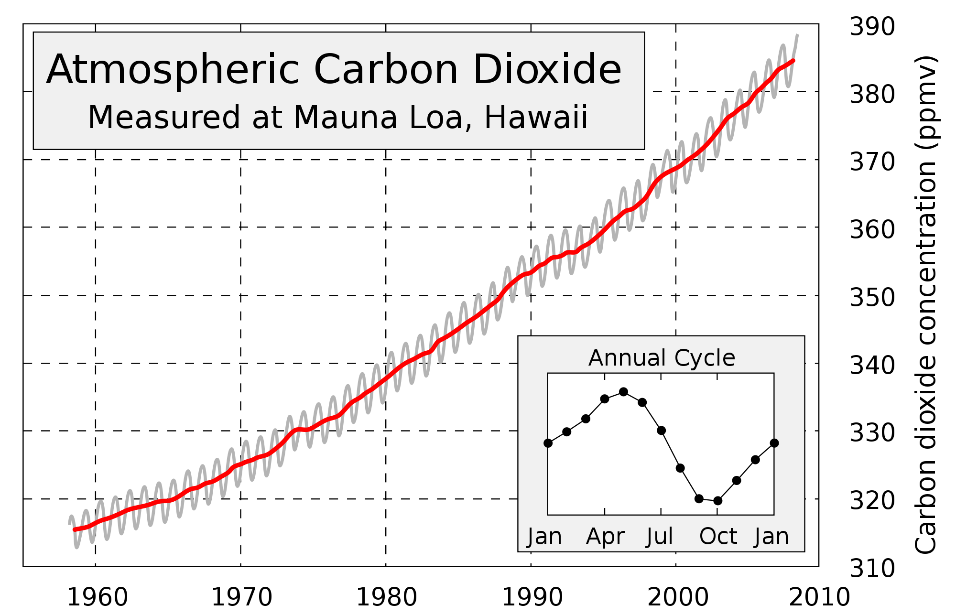
The Keeling Curve
Keeling (1960) observed: “at the South Pole the observed rate of increase is nearly that to be expected from the combustion of fossil fuel.”
Source: wikipedia
C. D. Keeling, The Concentration and Isotopic Abundances of Carbon Dioxide in the Atmosphere, Tellus, 12, 200-203, 1960

Slide 5
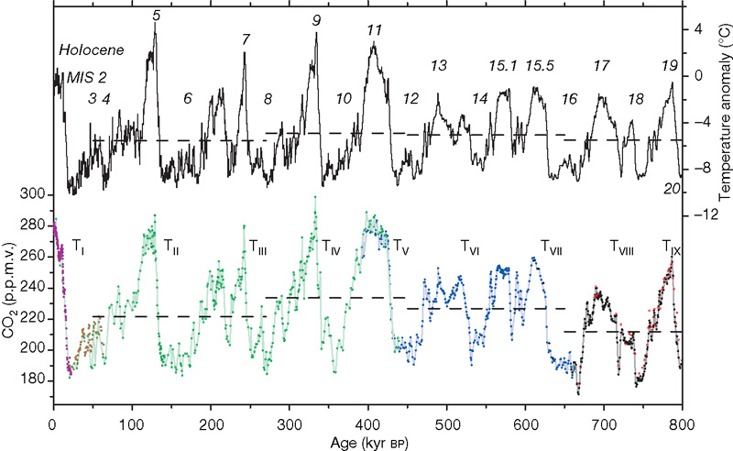
Air-trapped in Ice Bubbles (PCO2 and T)
390
Luthi et al. Nature (2008)

Slide 6
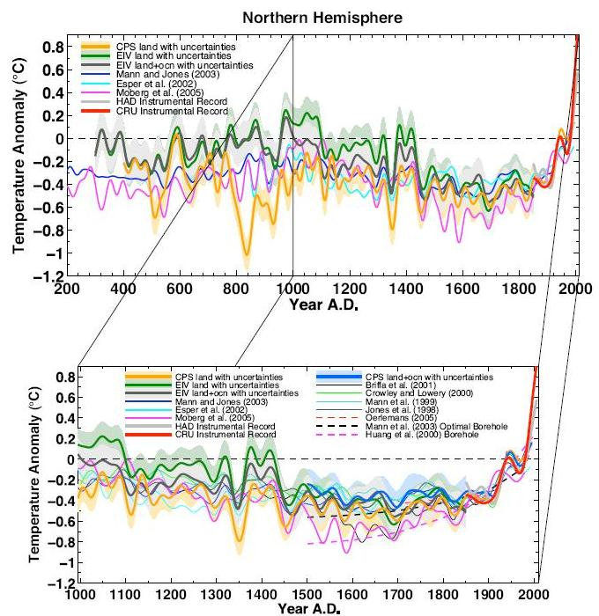
2000 years of climate
Including:
tree-ring,
marine sediment,
speleothem,
lacustrine,
ice core,
coral, and
historical documentary series
Mann et al. (2008) PNAS 105: 13252-13257

Slide 7
